Slide 1
Bank Customer Churn Prediction
Reinforcement Learning for Retention Strategies
DS Team 1: Ikjoo Oh, Beomseong Kim
December 13, 2024

Slide 2
Table of Contents
1. Background & Project Goals
5. Reinforcement Learning (RL)
5.1 Why RL?
5.2 Intro to Q-learning
5.3 Agent and Action Setup
5.4 Episode Performance Graph
2. Data Preprocessing
2.1 Overview of Preprocessing Steps
2.2 Feature Analysis
3. Exploratory Data Analysis
6. Challenges and Limitations
3.1 Data Characteristics
3.2 Visualizations of Key Features
3.3 Insights and Outliers
7. Streamlit Application Demo
4. Baseline Model: XGBoost
8. Future Work
4.1 Why XGBoost?
4.2 Hyperparameter Tuning
4.3 Model Performance
9.1 Plans for the Spring Semester
01

Slide 3
Background & Project Goals
1. Background
2. Project Goals
Limited experience with supervised learning methods.
Aimed to explore a new ML algorithm with a unique dataset for a new challenge.
Initially planned a Kaggle competition but shifted to familiar bank data due to complexity.
Develop a reinforcement learning model to identify optimal retention strategies for customers at risk of churning
Design an interactive interface for bank staff to input new customer data, predict churn probability and recommend personalized retention strategies
02

Slide 4
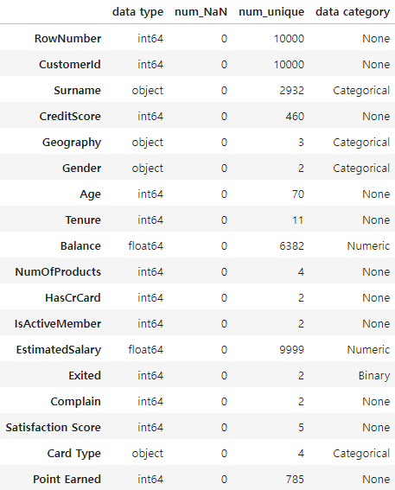

Data Preprocessing
Target / Dropped Features
Exited: Whether or not the customer left the bank
Row Number: Corresponds to the record or row number
Custom ID: Contains random values
Surname: Surname of the customer
Complain: Customer has complaint or not
The feature had nearly 100% of similarity to the target feature, which could influence our result
One-Hot Encoding
Geography
France, Spain, Germany
Gender
Male, Female
Card Type
Diamond, Gold, Platinum, Silver
Copyright 2024. LIKELION all rights reserved.
03

Slide 5
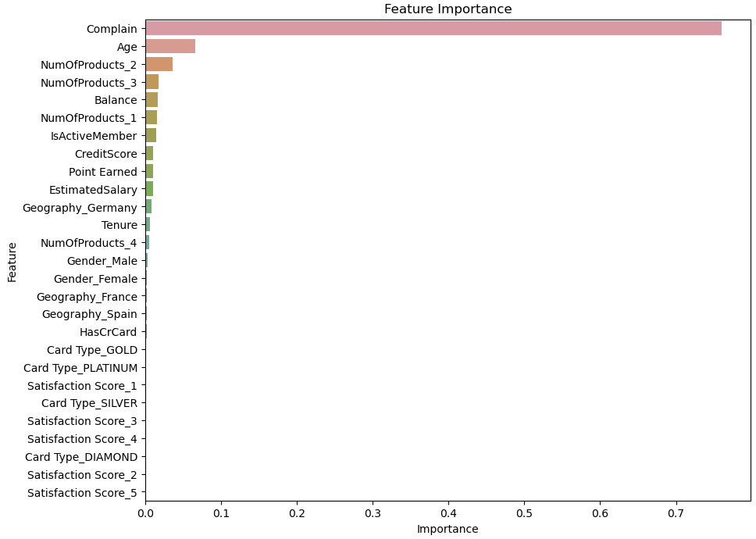
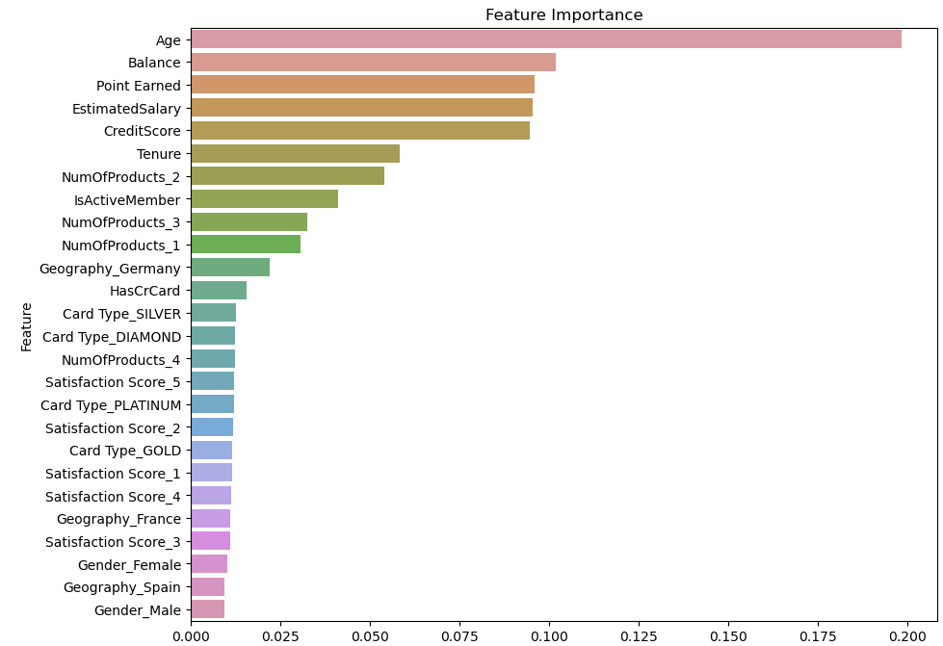
Exploratory Data Analysis
Focused EDA on features with higher importance
With Complain
Without Complain
vs
04

Slide 6
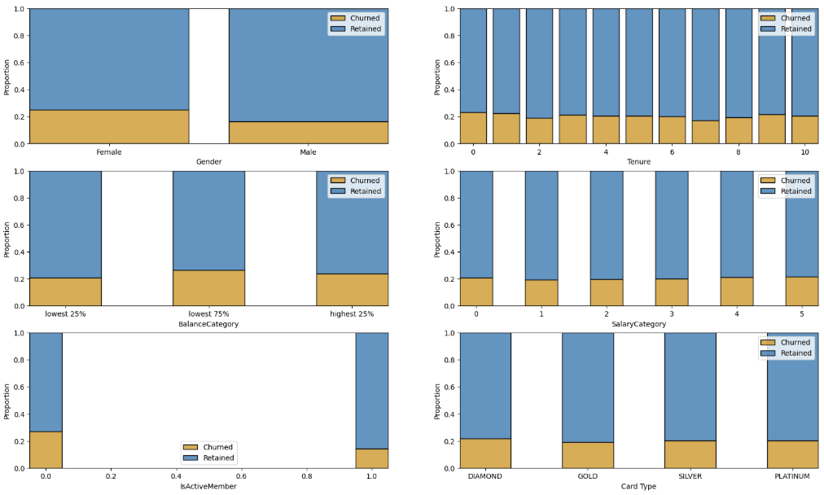
Exploratory Data Analysis
Reference Value
The criterion is the overall churn rate of 20.4%, used to understand the characteristics of each feature.
Conflict
Contrary to the expectation of discovering unique characteristics in specific features, most features showed a churn rate close to 20% across all segments, including those with high feature importance. This was attributed to the unique nature of the Kaggle dataset.
05

Slide 7
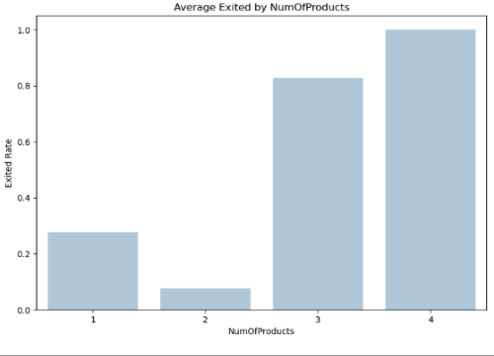
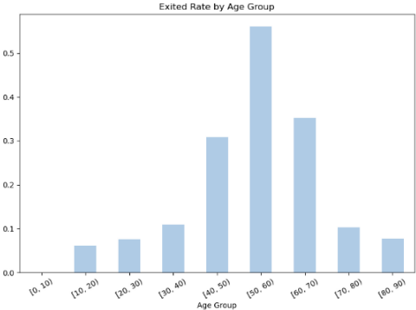
Exploratory Data Analysis
Number of Products
The churn rate dramatically increased when the customer bought 3 or more products
The high importance of the "NumofProducts" variable when the "Complain" variable is included might be due to the extreme churn rates observed for products 3 and 4.
Age
The churn rate dramatically increased in 50s and 60s
None of the section had churn rate of 20%

Slide 8
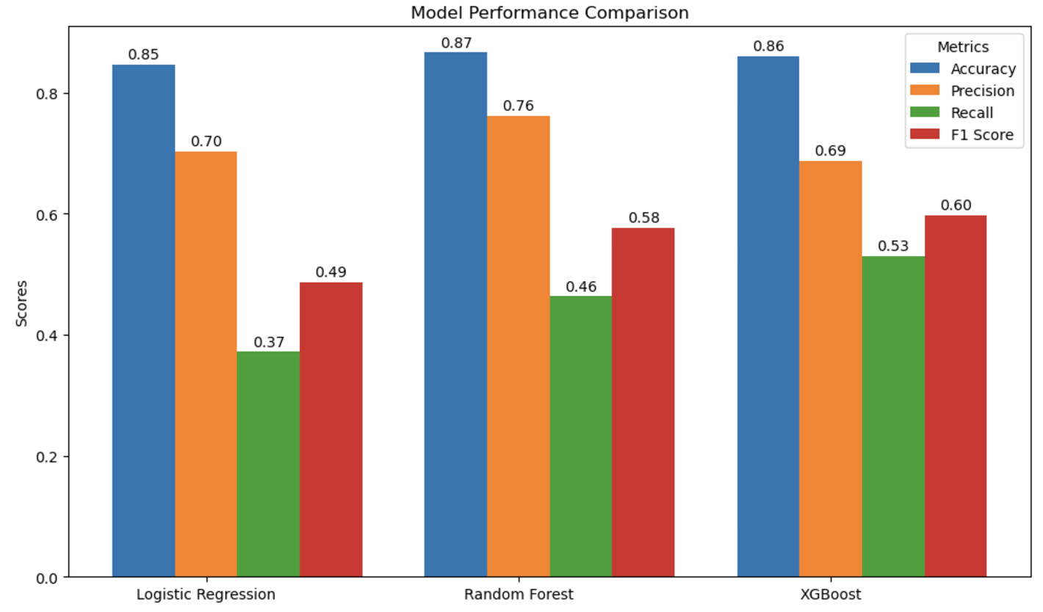
Baseline Model: XGBoost
1. Why do we use XGBoost in our project?
2. Intro to XGBoost
Goal: Increase TP (True Positive), Decrease FN (False Negative)
That is, We Need Better Recall Scores
a. An advanced implementation of the Gradient Boosting framework
b. Utilizes an ensemble of weak learners (decision trees) built sequentially to reduce errors and improve model performance
07

Slide 9
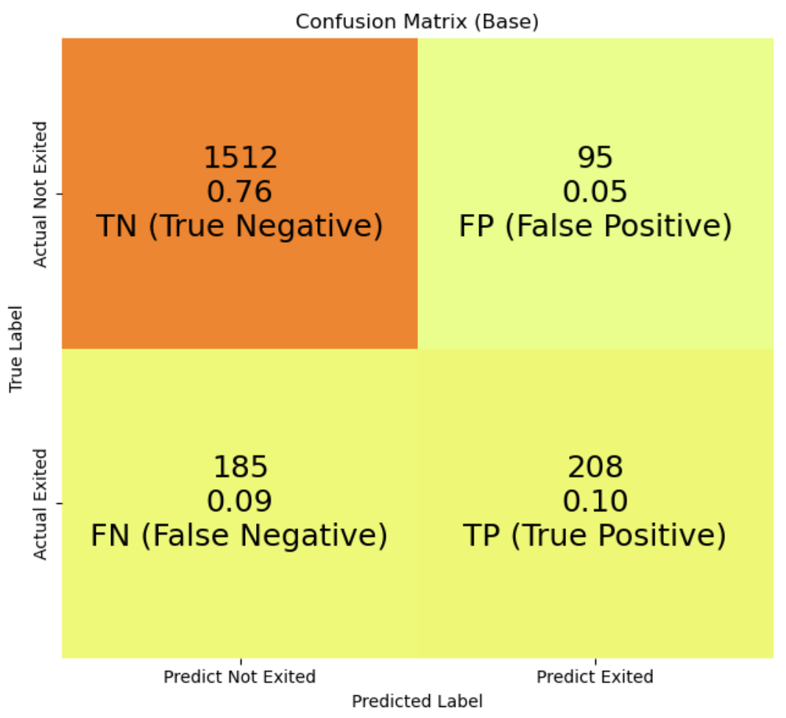
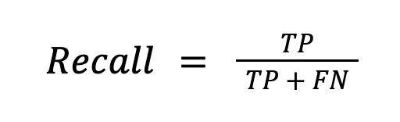
Baseline Model: XGBoost
- Baseline Xgboost Initial Confusion Matrix (Without Hyperparameter Tuning)
- With the initial model, our recall (True positive rate) score was 0.53 (208 / 208 + 185).
- Again, We need better Recall score
- Why?
To reduce false negatives and capture more customers likely to churn.
High recall ensures effective targeting of at-risk customers
TP = Customers who were predicted to churn and actually churned.
FN = Customers who were not predicted to churn but actually churned.
08

Slide 10
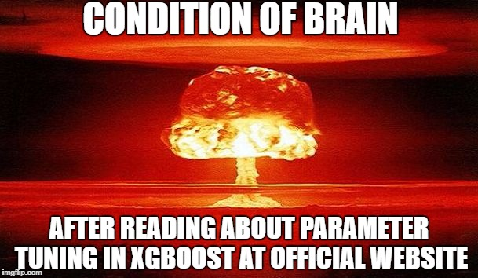
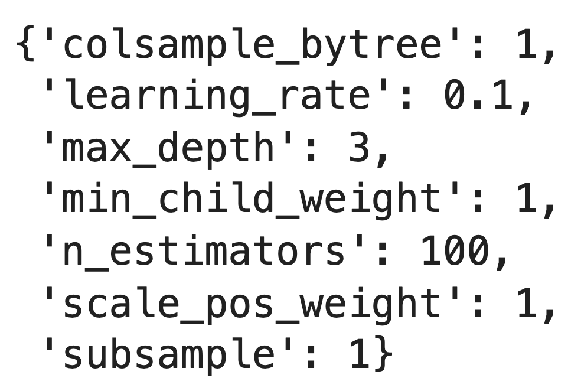
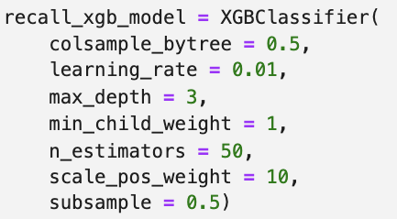
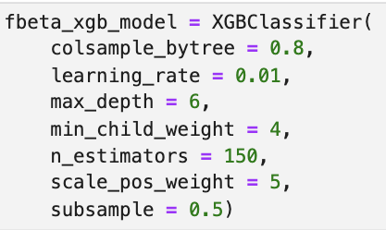
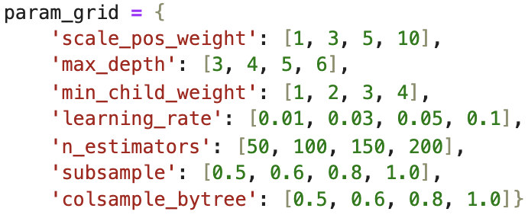
Baseline Model: XGBoost
- Initial Parameters (default)
- Tuning Process
- After Tuning Parameters
Used GrivSearchCV to explore optimal hyperparameter combinations.
Applied 5-fold cross-validation for robust evaluation.
Metric: fbeta_score (Optimal), recall_score
Prioritizes Recall over Precision to address class imbalance.
- Parameter Ranges
09

Slide 11
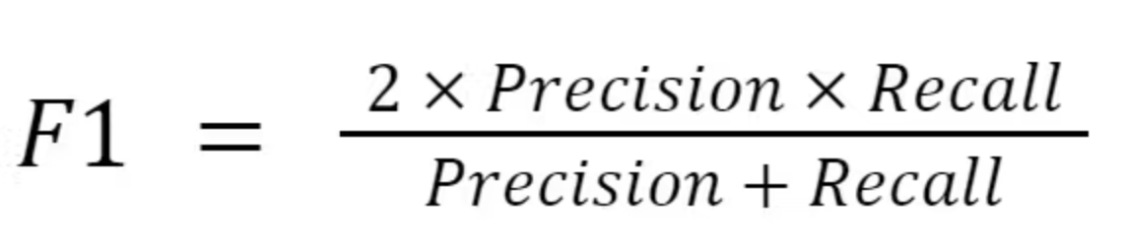
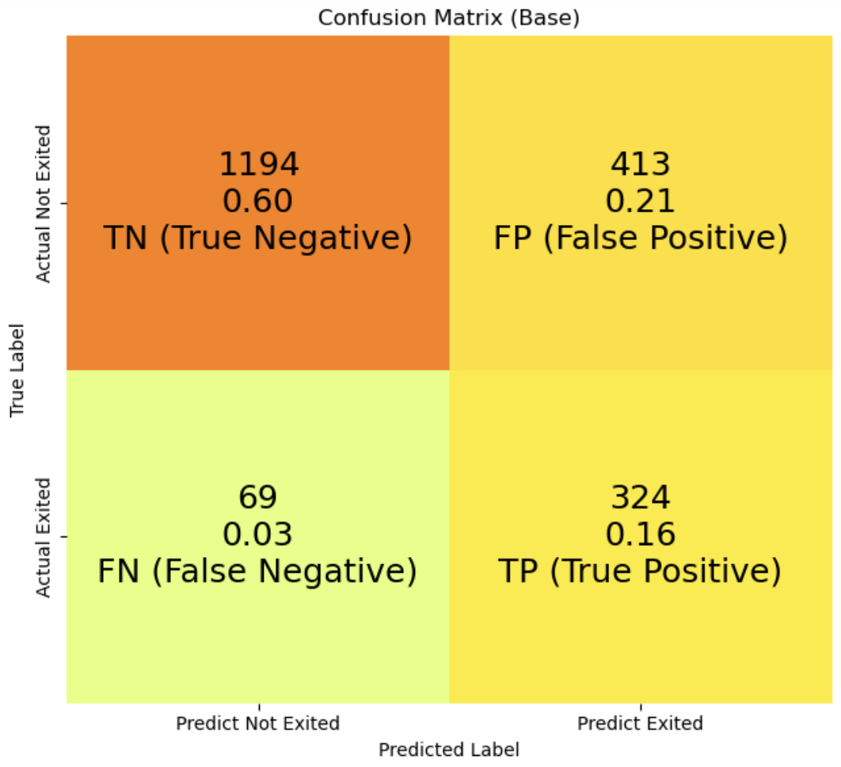
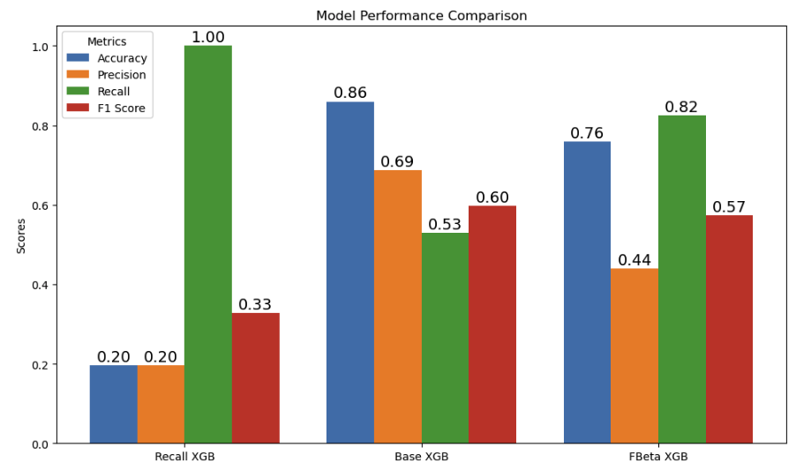
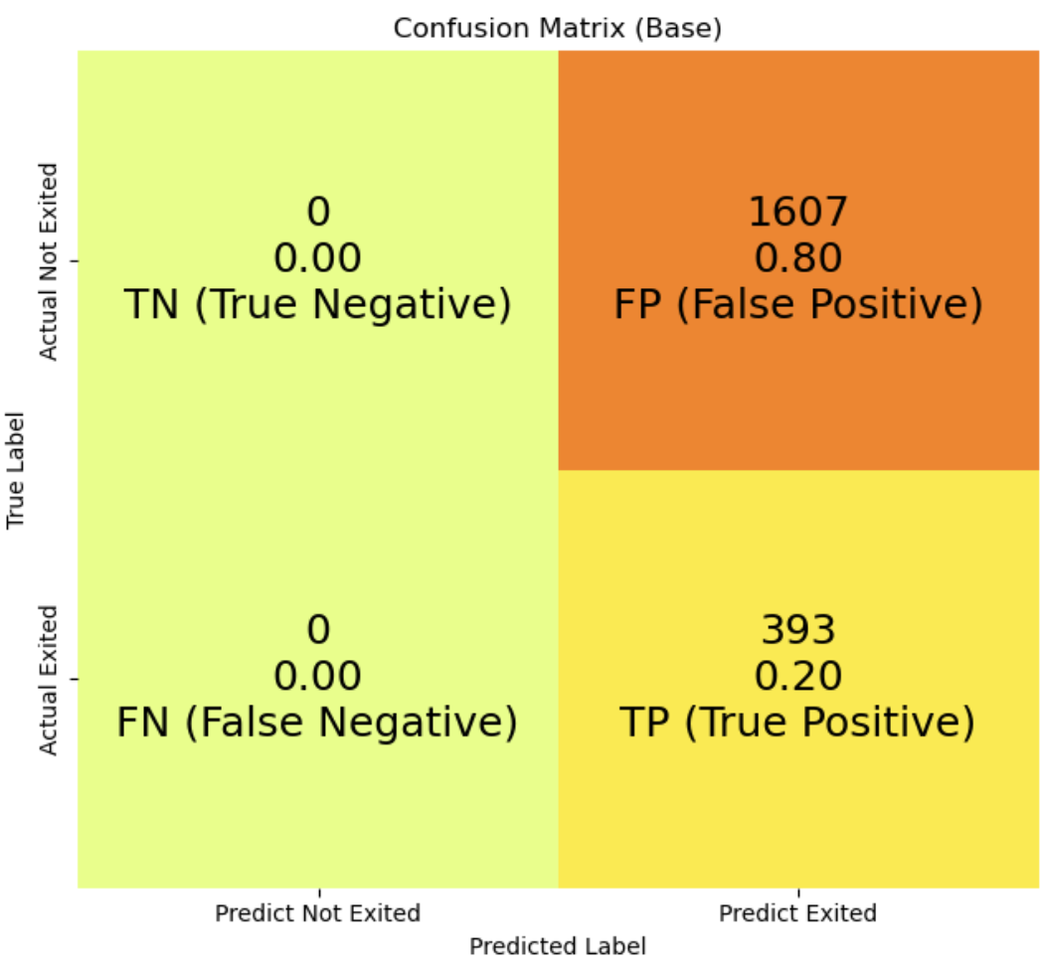
Baseline Model: XGBoost
- XGBoost Model Tuned for F2-Score Optimization
(Recall: 0.82, F1-Score: 0.57)
- Base XGBoost
(Recall: 0.53
F1-Score: 0.60)
- XGBoost Tuned for
Recall Optimization
(Recall: 1.00
F1-Score: 0.33)
- Best Model: Tuned with F2-Score
10

Slide 12
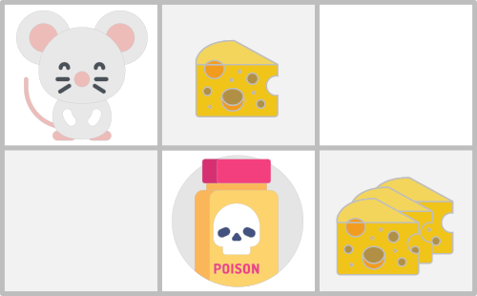
Why Reinforcement Learning & What is Q-learning?
Example Environment Setup
You always start at the same starting point
Goal: eat the big pile of cheese and avoid the poison
The episode ends if we eat the poison, eat the big pile of cheese or if we spent more than 5 steps
Example Action & Reward Setup
The action will be movement of the mice in each tick
+10 reward points: Going to the state with the big pile of cheese
-10 reward points: Going to the state with the poison and thus die
11

Slide 13
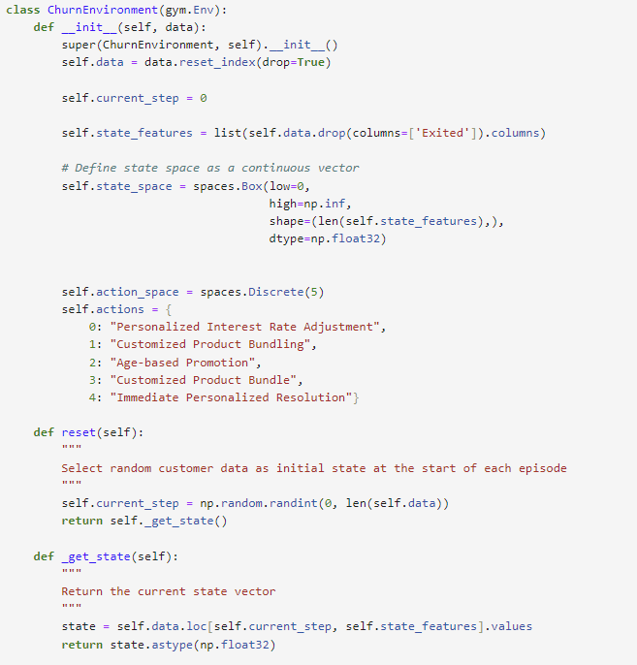
State & Action Setup
Actual Environment Setup
Starting point: Random single customer data
Goal: -5% on “Exited rate”(ER)
The episode ends if customer ER decreased by 5%, or used every action once.
Actual Action & Reward Setup
The action will be the promotion that will change customers feature value
+x reward points: Prevent leaking customers, and more rewards will be given with lower action used
-x reward points: Used every action but fail to lower 5%
12

Slide 14
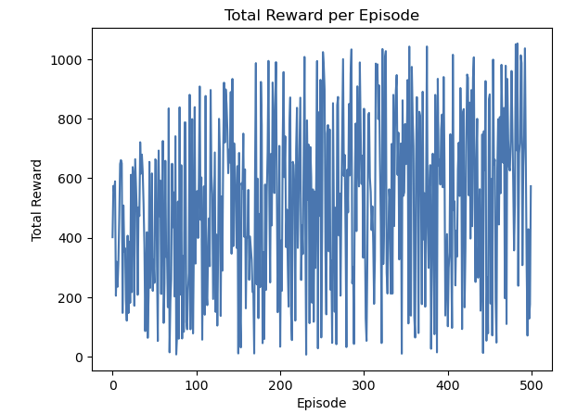
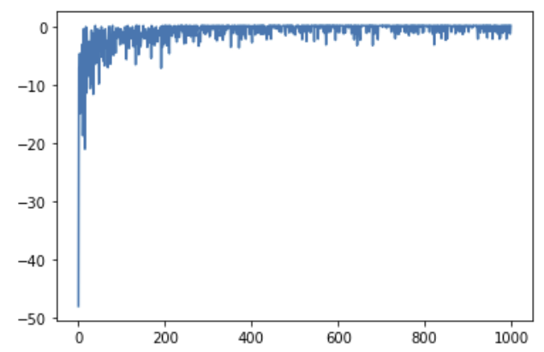
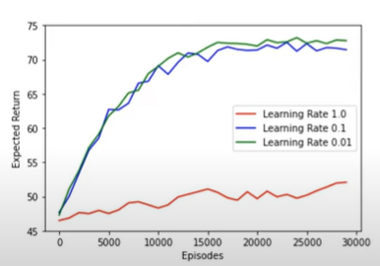
Result
Reality
Expected
13

Slide 15
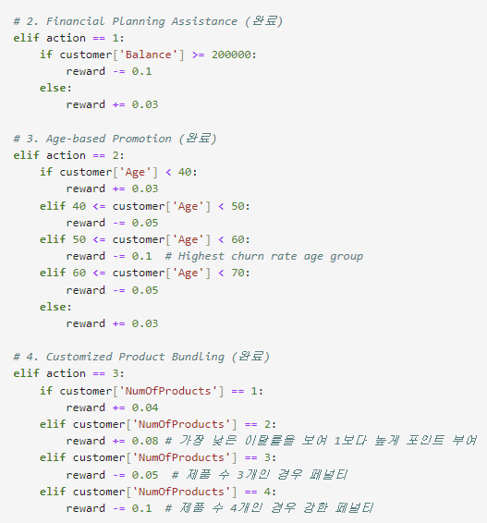
Challenges and Limitations
Incorrect Ending point of Episode
Starting point: Random single customer data
Goal: -5% on “Exited rate”(ER)
The episode ended only when every customer data was used
Incorrect Reward System
Original plan was to give rewards only at the end of the episode, however in our code the reward was given in each action
14

Slide 16
Streamlit Application Demo
Launch the Dashboard
15

Slide 17
Future Work
Environment, Action, and Reward setup
Correct episode ending point as we planned
Need More EDA based on ‘Age’
Specific action setup based on EDA
Need reasonable explanation in every single action setup
3. RL Algorithms Comparison
SARSA (State–action–reward–state–action)
Deep Q-Networks (DQN)
4. Still need better XGBoost model
Improve F1-Score (Bayesian optimization, Custom loss function)
Effective Feature Engineering
Address Class Imbalance (SMOTE)
2. Hyperparameter Optimization
Optimize parameters (Learning rate, Gamma, Epsilon)
Use Optuna framework to optimize parameters
16

Slide 18
Bank Customer Churn Prediction
Q & A
17

